Slide 1
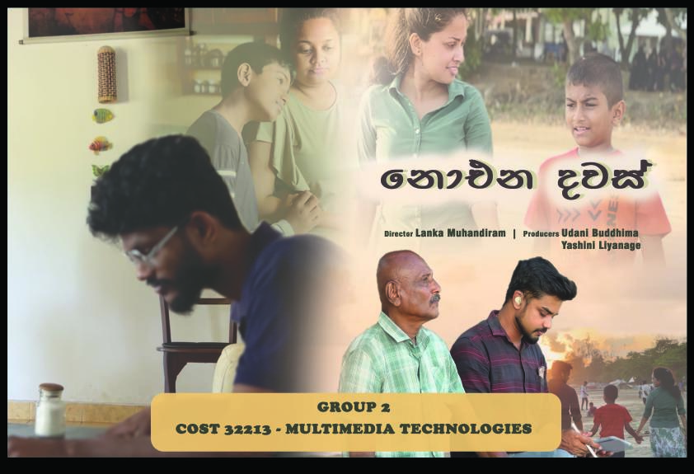



Slide 2


Content
Our Team
Introduction
DVD Cover
DVD Sticker
Video
Challenges
Lessons that we learned
Special Thanks

Slide 3
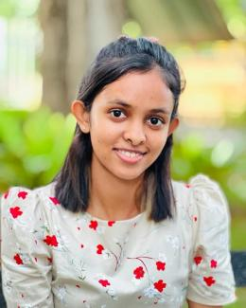

Our Team
HS/2019/0422
B.P.U. Buddhima
(Team Leader)
Project Manager
Producer
Video Editor
Story Boarder

Slide 4

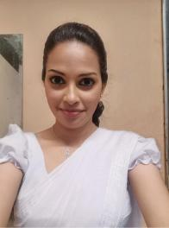
HS/2019/0792
D.U.Y. Liyanage
Multimedia Designer/Producer
Actress
HS/2019/0575
H.M.C.D. Lanka Muhandiram
Director/Script Writer

Slide 5

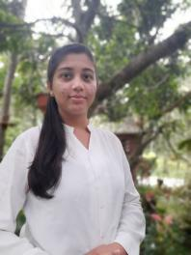
HS/2019/0904
D.E. Sacheeka
Audio Recording
HS/2019/0484
H.M.N.Nimnali
Audio Recording/Report writer Presentation Maker

Slide 6




Introduction
Name - නොඑන දවස් (Irretrievable days)
The short film emphasizes the value of quality time with family, touching on themes of balancing work and personal life. It serves as a reminder to cherish moments shared with loved ones amidst life's demands.
Purpose -
Target audience -
For families and young professionals, reminding them to make time for family despite work pressures, and resonating with those reflecting on life choices and the importance of family connections.
Duration -
9.52 min

Slide 7

DVD
Cover

Slide 8
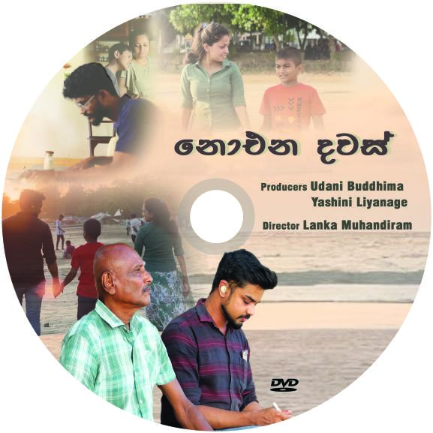


DVD Sticker

Slide 9

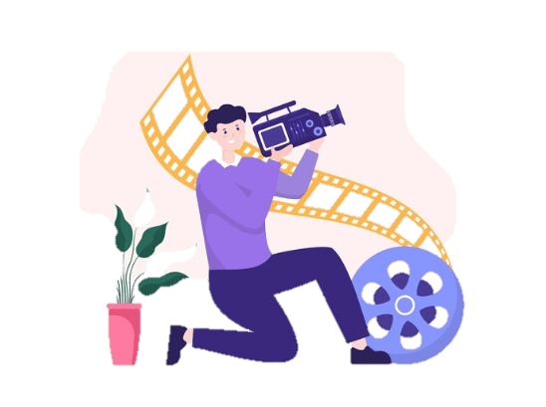
Video
Youtube URL : https://youtu.be/vEEGh9As2Ow

Slide 10
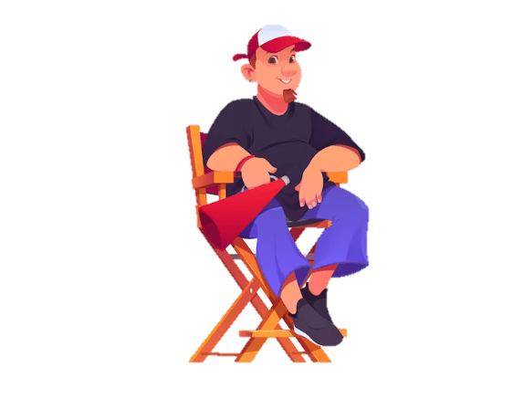

Challenges

Slide 11



Wind noise and other environmental factors at both the locations have compromised the audio quality of the dialogue captured during filming. To overcome it we had to do the dubbing for several parts & replace sounds from the environment for those scenes.
For shooting we couldn’t afford a DV camcorder or a DSLR camera , instead that we used iPhone 13 Pro Max for all filming.
Indoor lighting and camera settings. When shooting house scenes, some angles are dark, but we use lighting equipment (Ring Fill Light with Stand) to overcome this.
According to our script, we had to shoot in 2 locations. We tried to do all shoots in one day so we looked for the best and most comfortable location for all members(Including crew). Gladly Mr.Osmand liked to provide the location so when the selecting location wasn't a big challenge. Actors also preferred it.

Slide 12
Lesson that we learned

Slide 13
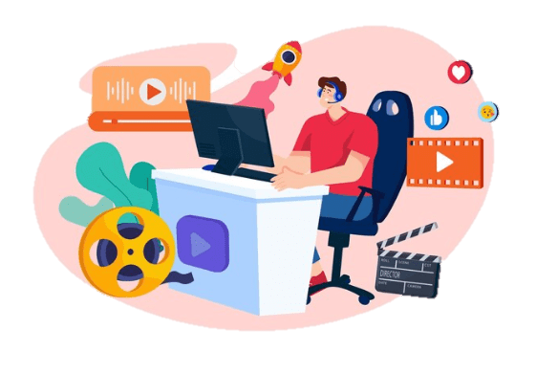
Collaboration and Creativity: Making a short film based on the script requires collaboration among the filmmaking team to overcome challenges and bring the story to life. It teaches valuable lessons about teamwork, problem-solving, and harnessing creativity to deliver a compelling narrative.
Following a schedule : Especially during our academic pursuits. Despite the time constraints we face, adhering to our schedule is crucial. This principle is repeatedly emphasized by our lecturers. Looking back, we realize the significance of this discipline.
Keep attention to the settings of the white balancing of a camera before shooting indoor video.
Use appropriate recording equipment and place in to correct positions.

Slide 14
Personal Improvements

Slide 15



Technical Skills:
Storytelling: Crafting a compelling narrative within a short timeframe requires focus and conciseness.
Visual Communication: Directing shots, framing scenes, and understanding lighting all become crucial aspects.
Project Management: Juggling various aspects like pre-production, filming, editing, and post-production requires organization and scheduling.

Slide 16
Personal Growth:
Problem-solving: Unexpected challenges are inevitable on set.
Communication: Collaborating effectively with actors, crew members, and editors is essential.
Time Management: Short films often have tight deadlines.
Discipline: The filmmaking process requires commitment and focus.
Overall, making short films is a rewarding experience that can lead to significant personal and professional development.

Slide 17

Audience Review

Slide 18


Special Thanks
Mr. Amila Helanuwan- Visiting lecturer (MMT) , Department of Industrial Management , Faculty of Science , University of Kelaniya.
B.P. Osmand - Location provider.
G.B. Sandun Srimal / Pramuditha Dilshan - Videography and Camera&Gimbal
B.K. Prashan Dilruk - Helped with Lighting equipment & acting.
Sakeer Ahamed & Sudesh Kumarasiri - Helped with Dubbing

Slide 19



THANK YOU!

